Slide 1
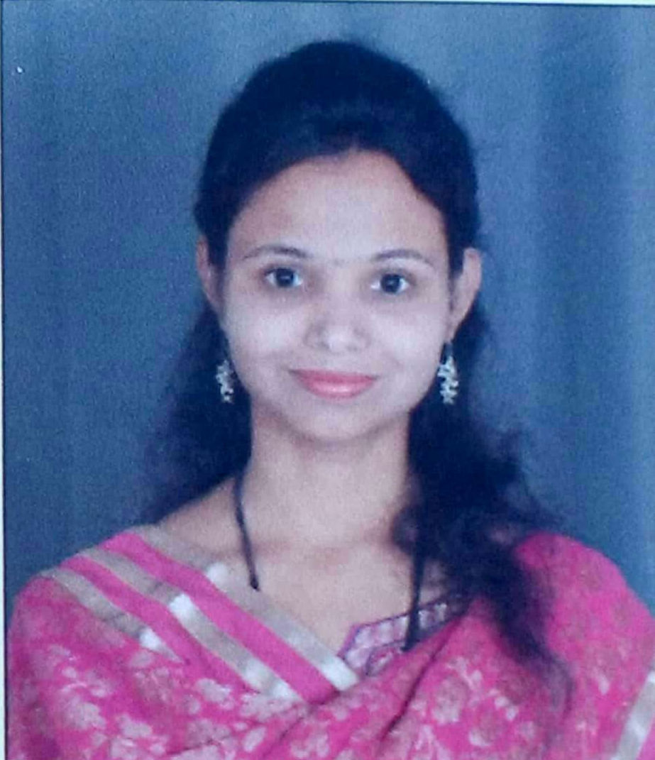
Engineering Mathematics-III
Mrs.: Ghadage Supriya Shivaji
M.Sc. Mathematics
VPKBIET BARAMATI

Slide 2
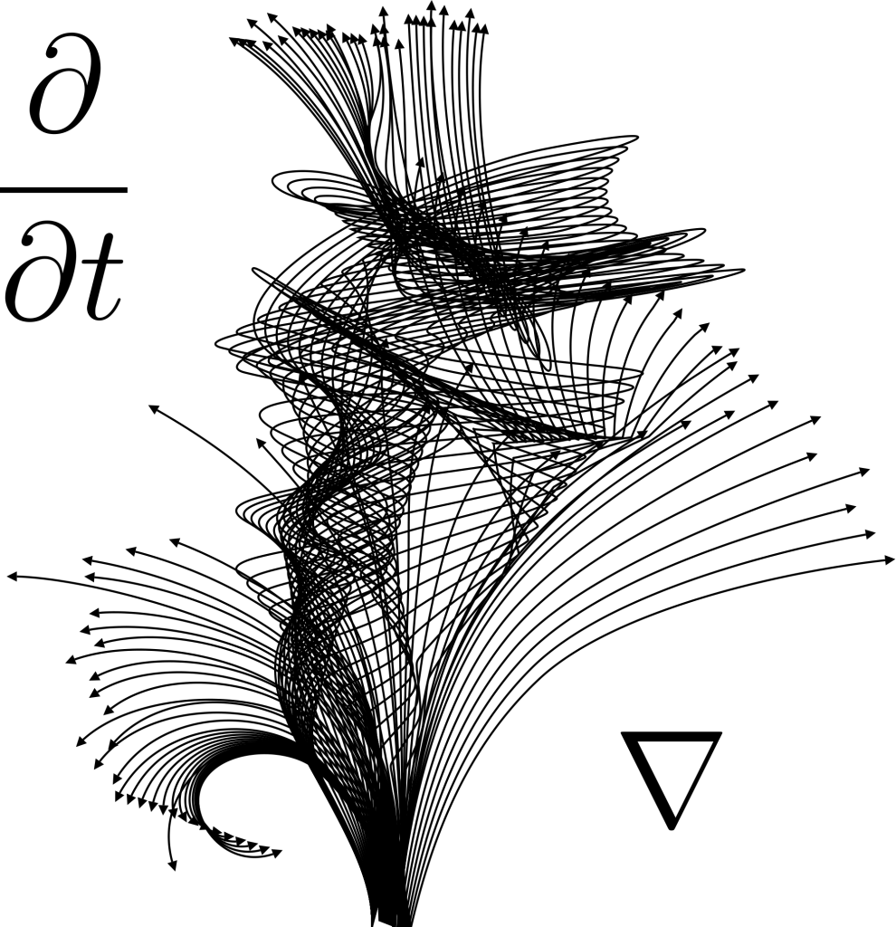
Unit No-I
Linear Differentia Equations(LDE) and Applications

Slide 3
Introduction
Differential equations are widely use in field of engineering and applied science. Use of differential equations is most prominent in subjects likes Circuit Analysis, theory of structures, vibrations, heat transfer, fluid mechanics etc.

Slide 4

Differential Equations
Differential Equations:
An equation which involves derivatives or differentials or differential coefficients, is called a differential equation.
E.g. 1) $\frac{dy}{dx}=\cos{x}$
2)$\frac{d^{2}y}{dx^{2}}+5\frac{dy}{dx}=e^{x}$
Types of differential equation:
Ordinary differential equation:
A differential equation is said to be an ordinary differential equation if all differential coefficients involve only one independent variable. $\frac{du}{dx}+\frac{dv}{dx}=10x , \frac{d^{2}y}{dx^{2}}+5\frac{dy}{dx}=e^{x}$
Partial differential equations:
A differential equation is said to be partial differential equation if all differential coefficients of the involve two or more independent variables.
e.g. x$\frac{∂u}{∂x}+y\frac{∂u}{∂y}=xy$

Slide 5

Linear differential equation
Linear differential equation: A differential equation which contains the differential coefficients and the dependent variable in the first degree, does not involve the product of a derivative with another derivative or with dependent variable, and in which the coefficients are constants is called a linear differential equation with constant coefficients.
The general form of linear diff. equation is
$a_{0}\frac{d^{n}y}{dx^{n}}+a_{1}\frac{d^{n−1}y}{dx^{n−1}}$+$a_{2}\frac{d^{n−2}y}{dx^{n−2}}$+…+$a_{n−1}\frac{dy}{dx}$+$a_{n}y=f(x)$.
Where $a_{0}$,$a_{1},$$a_{2},…,$$a_{n}$ are constant and f(x) is function of x or constant.
Let, $\frac{d}{dx}=D ,\frac{dy}{dx}=Dy$$\frac{d^{n}y}{dx^{n}}$=$D^{n}y$ ,here symbol D is differential operator.
In general also we can write equation as
$a_{0}D^{n}y+a_{1}D^{n−1}y$+$a_{2}D^{n−2}y$+…+$a_{n−1}Dy$+$a_{n}y=f(x)$.
$(a_{0}D^{n}+a_{1}D^{n−1}$+$a_{2}D^{n−2}$+…+$a_{n−1}D$+$a_{n})y=f(x)$.
$∅\left(D\right)y=f(x)$ where $∅\left(D\right)=a_{0}D^{n}+a_{1}D^{n−1}\text{+}a_{2}D^{n−2}\text{+…+}a_{n−1}D\text{+}a_{n}$

Slide 6

Auxiliary Equation(A.E.)
Consider the linear differential equation
$(a_{0}D^{n}+a_{1}D^{n−1}$+$a_{2}D^{n−2}$+…+$a_{n−1}D$+$a_{n})y=f(x)$.
i.e. $∅\left(D\right)y=f(x)$
Its Auxiliary equation is
$∅\left(D\right)=a_{0}D^{n}+a_{1}D^{n−1}\text{+}a_{2}D^{n−2}\text{+…+}a_{n−1}D\text{+}a_{n}$= 0
i.e. $∅\left(D\right)=0$
Example: $4\frac{d^{3}y}{dx^{3}} −6\frac{d^{2}y}{dx^{2}}+4y=e^{x}$
(4$D^{3}−6D^{2}+4)y=e^{x}$
Auxiliary equation is
4$D^{3}−6D^{2}+4=0$

Slide 7


General solution of linear D.E. $∅\left(D\right)y=0$
The solution of the DE involves two parts.
a) Complementary function (CF), b) Particular integral (PI)
Consider the linear differential equation $∅\left(D\right)y=0$
Solution of $∅\left(D\right)y=0$ is also called as Complementary Function (C.F.) of linear D.F.
To find C.F.
we have to write auxiliary equation i.e.$∅\left(D\right)=0$
Find the roots of equation $∅\left(D\right)=0$
Roots of A.E. may be real or complex repeated or non repeated.
Solution of A.E. depends upon the nature of roots .
Case –I: When the roots are real and distinct
Roots are real and distinct : If m₁, m₂,… $m_{n}$ are real and distinct roots, then
C.F.=${ y}_{c}=c_{1}e^{m_{1}x}+c_{2}e^{m_{2}x}$+$c_{3}e^{m_{3}x}$+…+$c_{n}e^{m_{n}x}$.

Slide 8


General solution of linear D.E. $∅\left(D\right)y=0$
Example:
$\frac{d^{2}y}{dx^{2}}+5\frac{dy}{dx}+6y=0$
Solution:
$\frac{d^{2}y}{dx^{2}}+5\frac{dy}{dx}+6y=0$ ($D^{2}+5D+6)y=0$
A.E. $D^{2}+5D+6$ = 0 $∴D=−3 and D=−2$
General solution is $y=C_{1}e^{−3x}$+$C_{2}e^{−2x}$

Slide 9

General solution of linear D.E. $∅\left(D\right)y=0$
Case-II: Roots are real and repeated
Suppose
m₁ =m₂ are repeated and other are non repeated roots then general solution is
C.F.=${ y}_{c}={(c}_{1}+c_{2}x)e^{m_{1}x}$+$c_{3}e^{m_{3}x}$+…+$c_{n}e^{m_{n}x}$.
If three roots are repeated then
C.F.=${ y}_{c}={(c}_{1}+c_{2}x+c_{3}x^{2})e^{m_{1}x}$+$c_{4}e^{m_{4}x}$+…+$c_{n}e^{m_{n}x}$.
2)$\frac{d^{3}y}{dx^{3}} −2\frac{d^{2}y}{dx^{2}}+\frac{dy}{dx}=0$
Solution:
$\frac{d^{3}y}{dx^{3}} −2\frac{d^{2}y}{dx^{2}}+\frac{dy}{dx}=0$
$D^{3}y−2D^{2}y+Dy=0 ∴A.E. = \left(D^{3}−2D^{2}+D\right)=0$
$∴D\left(D^{2}−2D+1\right)=0$$D{(D−1)}^{2}=0$
$D\left(D−1\right)\left(D−1\right)=0$ D=0, D=1,D=1
Here D=0 is real and distinct root and D=1 is real and repeated
$y=C_{1}e^{0x}+{(C}_{2}$+$C_{3}x)e^{x}$$y=C_{1}+{(C}_{2}$+$C_{3}x)e^{x}$

Slide 10


General solution of linear D.E. $∅\left(D\right)y=0$
Example:$\left(D^{4}−2D^{3}+D^{2}\right)y=0$
Solution: A.E. =$D^{4}−2D^{3}+D^{2}=0$
$D^{2}\left(D^{2}−2D+1\right)=0$
$D^{2}{(D−1)}^{2}=0$
$∴D^{2}=0$ and ${(D−1)}^{2}=0$
∴ $D=0,D=O,D=1,D=1$
General solution is $y={(C}_{1}$+$C_{2}x)e^{0x}+{(C}_{3}$+$C_{4}x)e^{x}$

Slide 11


General solution of linear D.E. $∅\left(D\right)y=0$
Example: $\frac{d^{3}y}{dx^{3}} −3\frac{d^{2}y}{dx^{2}}+3\frac{dy}{dx}−y=0$
Solution:$D^{3}y−3D^{2}y+3Dy−y=0$
$∴A.E. = \left(D^{3}−3D^{2}+3D−1\right)=0$
by using synthetic division we find roots
roots are -1 ,-1,-1.
General solution is $y={(C}_{1}$+$C_{2}x+C_{3}x^{2})e^{−x}$

Slide 12

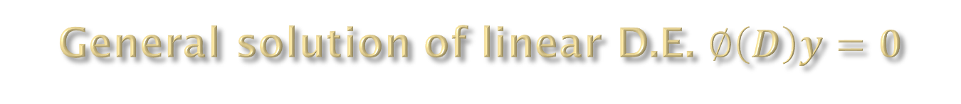
General solution of linear D.E. $∅\left(D\right)y=0$
Case – III: Roots of A.E. are imaginary
Let D = $α±iβ$ are two roots of A.E.
Then G.S. of ∅(𝑫)𝒚=𝟎 is
$$y=e^{αx}(c_{1}\cos{βx}+c_{2}\sin{βx})$$
e.g. If $D=2±3i$ roots then $α=2,β=3$
G.S. $y=e^{2x}(c_{1}\cos{3x}+c_{2}\sin{3x})$
Example:($D^{2}+2D+5)y=0$
Solution:($D^{2}+2D+5)y=0$
A.E. $D^{2}+2D+5=0$
By using the formula D= $\frac{−b±\sqrt{b^{2}−4ac}}{2a}$ we get D=$−1±2i$
Here $α=−1,β=2$
G.S. $y=e^{−1x}(c_{1}\cos{2x}+c_{2}\sin{2x})$

Slide 13


General solution of linear D.E. $∅\left(D\right)y=0$
Example:$\frac{d^{2}y}{dx^{2}}+4y=0$
Solution:$\frac{d^{2}y}{dx^{2}}+4y=0$
($D^{2}+4)y=0$
A.E. $D^{2}+4$= 0
$∴D=0±2i$
G.S. $y=e^{0x}(c_{1}\cos{2x}+c_{2}sin2{x})=c_{1}\cos{2x}+c_{2}sin2{x}$

Slide 14

General solution of linear D.E. $∅\left(D\right)y=0$
Example: ${(D}^{3}+7D^{2}+16D+10)$y=0
Solution: ${(D}^{3}+7D^{2}+16D+10)$y=0
A.E.=${(D}^{3}+7D^{2}+16D+10)$=0
One root of the equation is -1, to find other roots use synthetic division we get quadratic equation having roots $−3±i.$
$∴$ roots of A.E. are -1,$−3±i.$
Here $α=−3,β$=1
G.S. y = $e^{−3x}\left(c_{1}\cos{x}+c_{2}\sin{x}\right)+C_{3}e^{−x}$

Slide 15

General solution of linear D.E. $∅\left(D\right)y=0$
Case – IV: Roots of A.E. are imaginary and repeated.
Let D = $α±iβ$, D $=$$α±iβ$are roots of A.E.
Then general solution is
$$y=e^{αx}[\left(c_{1}+c_{2}x\right)\cos{βx}+\left(c_{3}+c_{4}x\right)\sin{βx}]$$
e.g. If D $=$2$±3i$, 2$±3i$
$$y=e^{2x}[\left(c_{1}+c_{2}x\right)\cos{3x}+\left(c_{3}+c_{4}x\right)\sin{3x}]$$

Slide 16

General solution of linear D.E. $∅\left(D\right)y=0$
Example: ${\text{(}D^{2}+9)}^{3}y=0$
Solution: ${\text{(}D^{2}+9)}^{3}y=0$
A.E. ${\text{(}D^{2}+9)}^{3}=0$
$∴ D^{2}+9=0$,$D^{2}+9=0$,$D^{2}+9=0$
$∴D^{2}=−9 ,$$D^{2}=−9$, $D^{2}=−9$
$∴D=±3i$,$D=±3i$,$D=±3i$
Roots are imaginary and repeated 3 times
General solution is
$y=e^{0x}[\left(c_{1}+c_{2}x+c_{3}x^{2}\right)\cos{3x}+\left(c_{4}+c_{5}x+c_{6}x^{2}\right)\sin{3x}]$
$$y= [\left(c_{1}+c_{2}x+c_{3}x^{2}\right)\cos{3x}+\left(c_{4}+c_{5}x+c_{6}x^{2}\right)\sin{3x}]$$

Slide 17

Examples
Solve the following differential equations:
$$\frac{d^{2}y}{dx^{2}}−5\frac{dy}{dx}−6y=0$$
Ans: Given D.E. is ($D^{2}−5D−6)y=0$
A.E. is
roots are 6 and -1(roots are real and distinct)
General solution is $y=C_{1}e^{6x}$+$C_{2}e^{−x}$

Slide 18

Homework
Solve the following differential equation:
2$\frac{d^{2}y}{dx^{2}}−\frac{dy}{dx}−10y=0$
Ans:$y=C_{1}e^{−2x}$+$C_{2}e^{(\frac{5}{2})x}$
2)$\frac{d^{3}y}{dx^{3}}+2\frac{d^{2}y}{dx^{2}}+\frac{dy}{dx}=0$
Ans:$y=C_{1}+{(C}_{2}$+$C_{3}x)e^{−x}$
3)${(D}^{3}+6D^{2}+11D+6)$y=0 Ans:$y=C_{1}e^{−3x}$+$C_{2}e^{−2x}{+C}_{3}e^{−3x}$
4) 4$y^{′′}−8y^{′}+7y=0$
Ans:y = $e^{x}\left(c_{1}\cos{\frac{\sqrt{3}}{2}x}+c_{2}\sin{\frac{\sqrt{3}}{2}x}\right)$

